Slide 1
طراحی سيستم های ديجيتال برنامه پذير

Slide 2
طراحی سيستم های ديجيتال برنامه پذير
Text Book:
م. صاحب‌الزمانی، طراحی کامپیوتری سیستم‌های دیجیتال، نشر شیخ بهایی، 1398
References:
P. Simpson, FPGA Design: Best Practices for Team-Based Reuse, Springer, 2nd Edition, 2015.
U. Heinkel et. al, The VHDL Reference: A Practical Guide to Computer-Aided Integrated Circuit Design including VHDL-AMS, Wiley, 2000.
Clive Maxfield, The Design Warrior’s Guide to FPGA, Elsevier, 2004.
E. Stavinov, 100 Power Tips for FPGA Designers, 2011.
Z. Salcic, A. Smailagic, Digital Systems Design and Prototyping Using Field-Programmable Logic and Hardware Description Languages, 2nd Edition, 2000.
Datasheets + References given in the slides

Slide 3
تراشه‌هاي منطقي برنامه‌پذير
Marking
Homework sets
Quizzes
Project
Midterm Exam
Final Exam
Software
Vivado
ModelSim

Slide 4
Digital Systems
Digital systems implementation:
Conventionally on CPU
Need for high speed
→ Increase frequency
→ Multi-core
→ Many-core (GPU)
Not enough speed for some applications
High power consumption

Slide 5
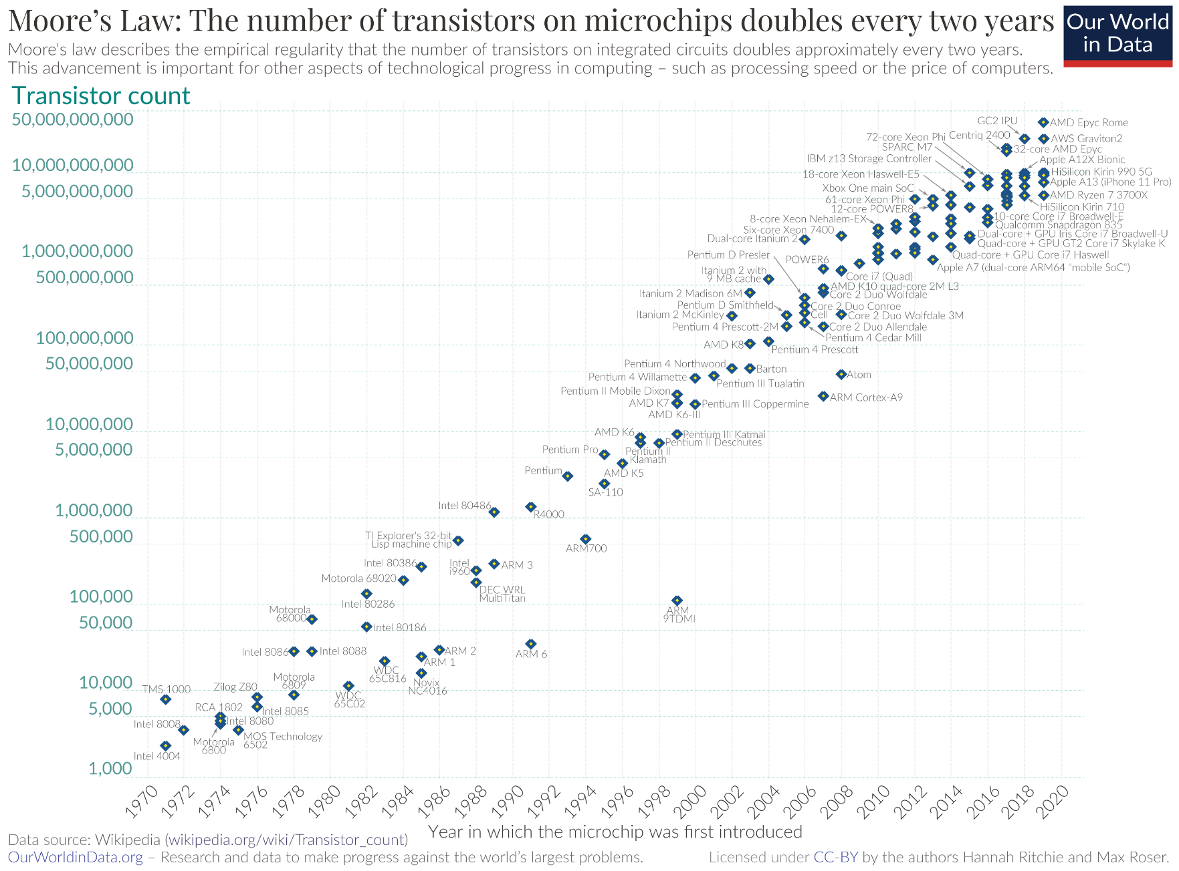
Technology Trend
Till 2005, transistor counts increased by Moore law

Slide 6
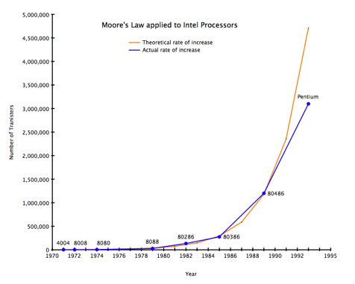
Technology Trend

Slide 7
Technology Trend
Till 2005, transistor counts increased by Moore law
Increasing number of cores instead of transistors
Predicted that multicore scaling may stop

Slide 8
Hardware vs. Software
Software
Slow:
Sequential: one instruction/operation at a time
Must fetch and execute each instruction
Memory bottleneck
Caches only mitigate the bottleneck
Easy to write, easy to debug, easy to modify

Slide 9
Hardware vs. Software
Hardware
Fast; no instruction fetch, decode, …
Can easily expose parallelism
More difficult to design, debug and modify

Slide 10
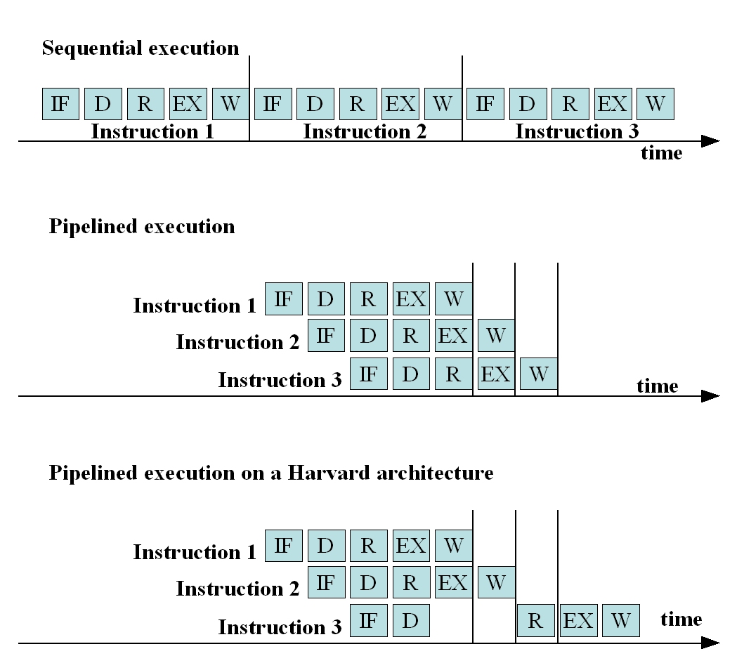
The Von Neumann Computer
Sequential execution
t_{cycle} = cycle execution time
One instruction needs t_{instruction} = 5*t_{cycle}
3 instructions: in 15*t_{cycle}
Pipelining:
One instruction needs t_{instruction} = 5*t_{cycle}
no improvement
3 instructions: in 7*t_{cycle} in the
ideal case.
→ Increased throughput
Even with pipeline, cache, etc., execution remains sequential.
if (a < b) then
{
d = a+b;
c = a*b;
}
else
{
d = a+1;
c = b-1;
}

Slide 11
Hardware Implementation
Complete execution in
parallel in one clock cycle
run-time = t_{clock}= delay of longest path from input to output
Hardware Example:
Implementation of a VN computer:
if (a < b) then
{
d = a+b;
c = a*b;
}
else
{
d = a+1;
c = b-1;
}
At least 3 instructions
run-time >= 3*t_{instruction}

Slide 12
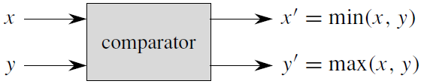
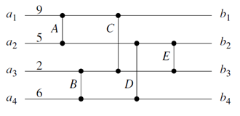
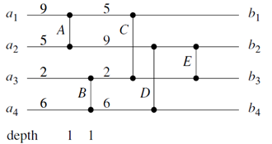
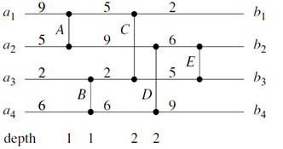
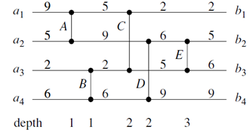
HW vs. SW Implementation Example

Slide 13
مدارهاي ديجيتال

Slide 14
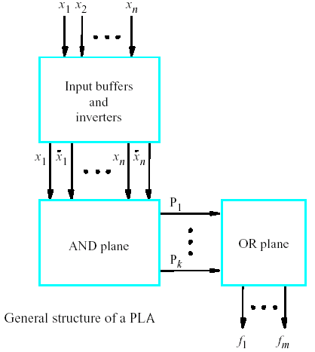
Programmable Logic Array (PLA)

Slide 15
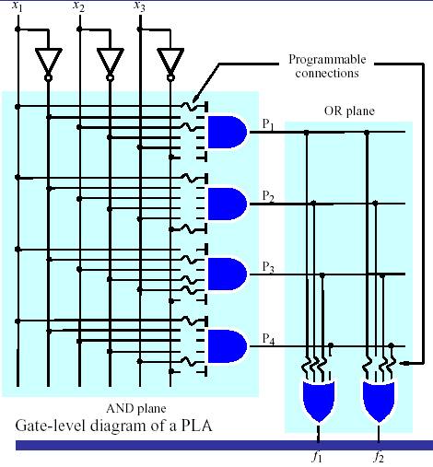
PLA

Slide 16
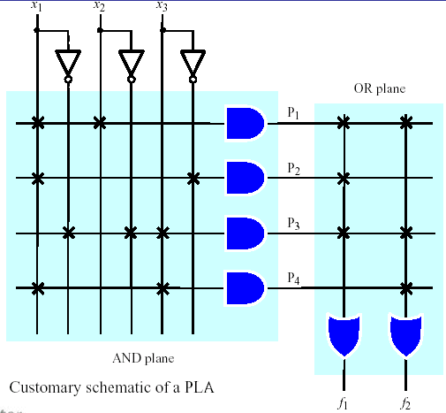
PLA

Slide 17
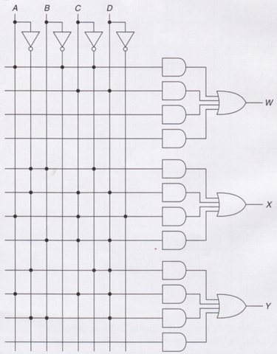
PAL
فقط AND Plane قابل برنامه ريزي.
W = AB’ C’′ + CD
X = A’BC’ + A’CD + ACD’ + BCD
Y = A’C’D + ACD + A’BD

Slide 18
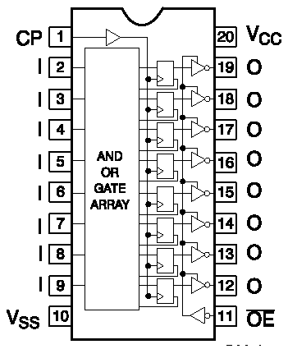
Programmable Array Logic (PAL)
براي پياده‌سازي مدارهاي ترتيبي معمولا در خروجي، FF قرار دارد.
PAL 16R8

Slide 19
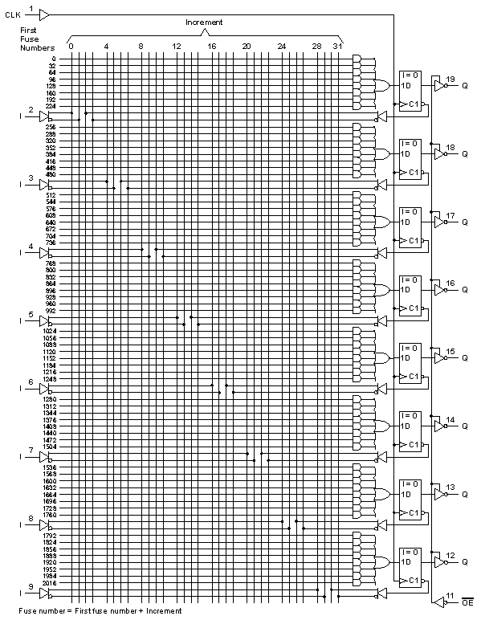
PAL 16R8

Slide 20
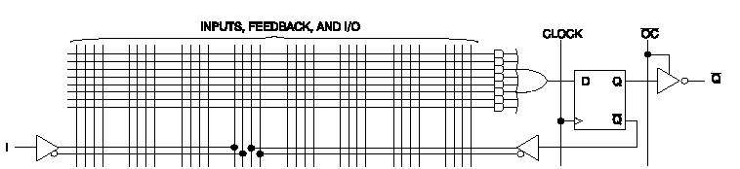
PAL 16R8

Slide 21
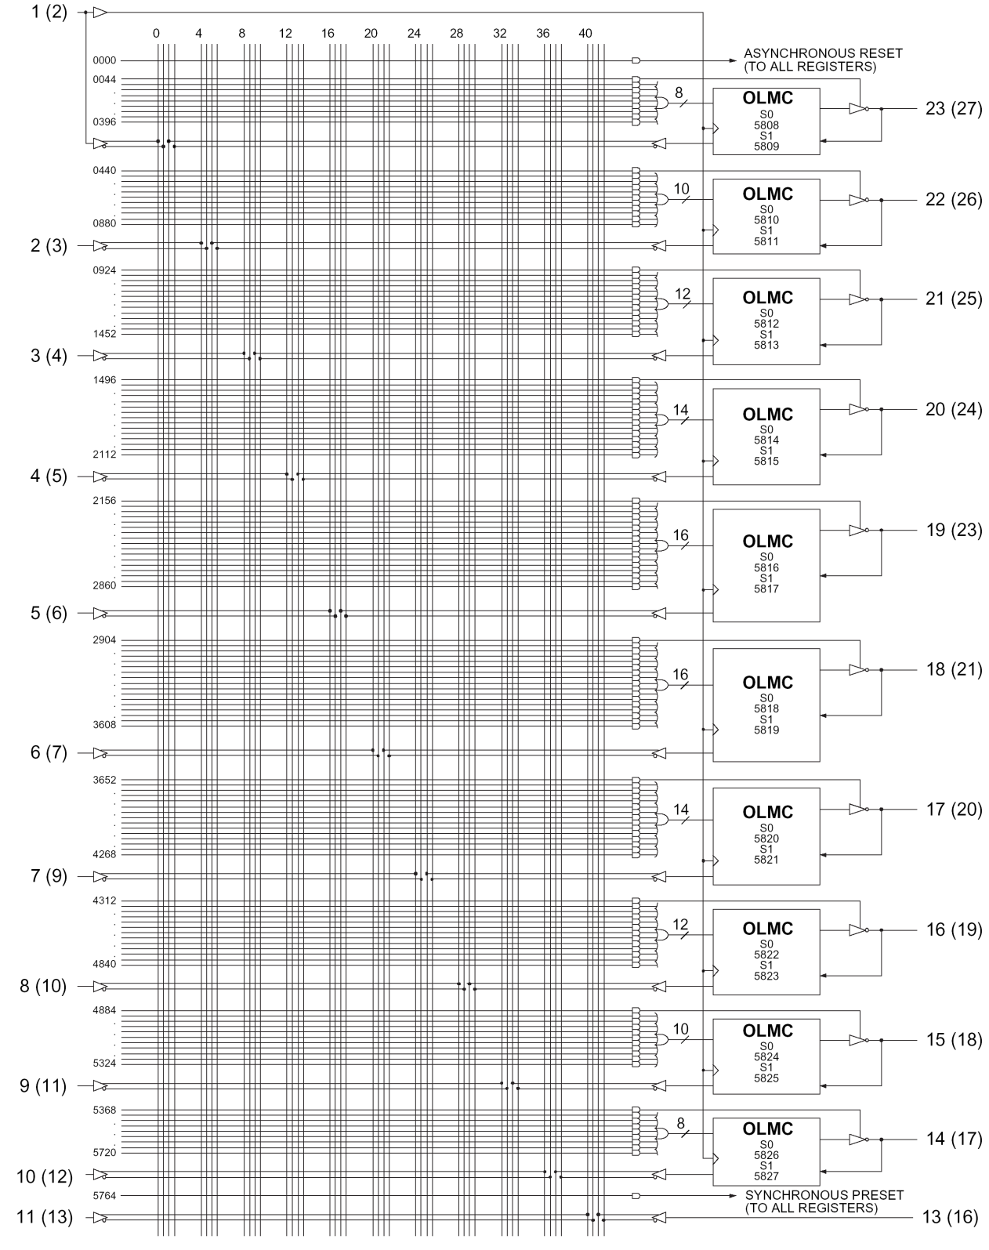
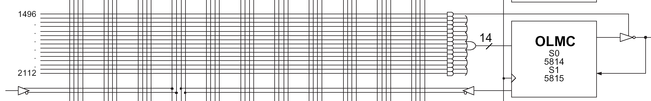
Simple PLD (SPLD) (22V10)

Slide 22
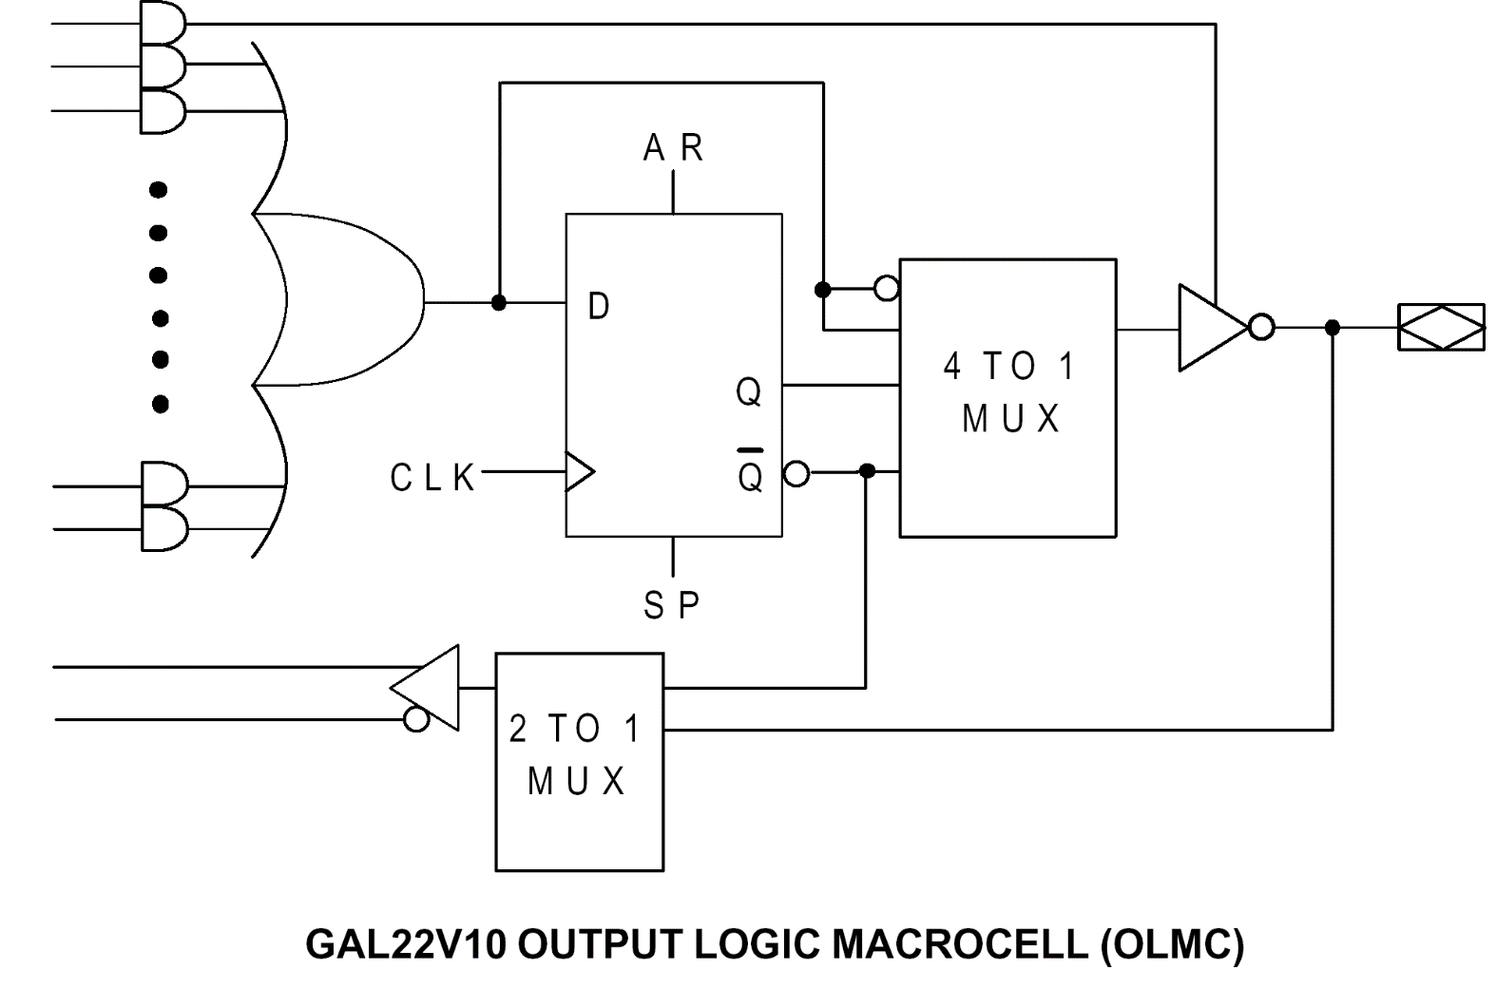
SPLD Macrocell

Slide 23
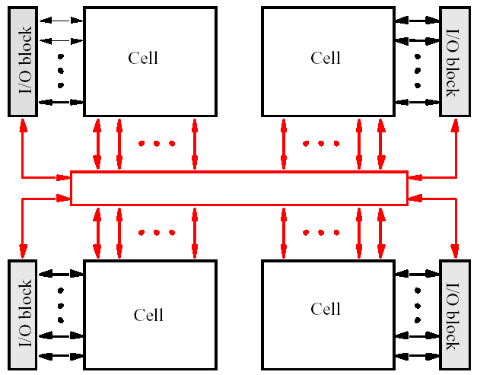
CPLD
Interconection Wires

Slide 24
بخشي از CPLD

Slide 25
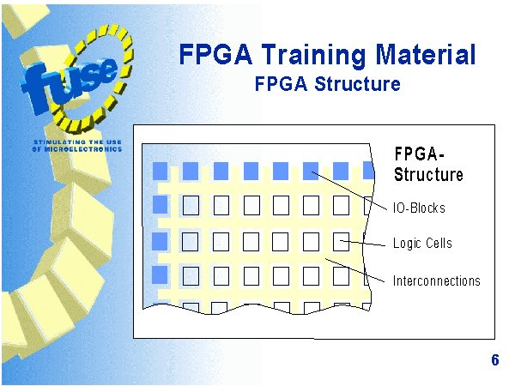
ساختار FPGA

Slide 26
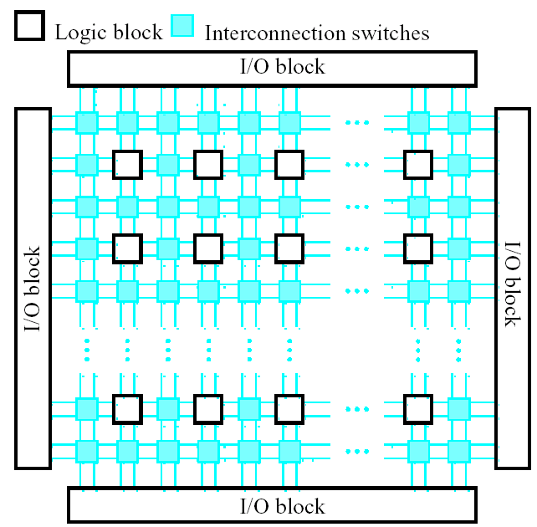
ساختار FPGA

Slide 27
Logic Cell

Slide 28
LUT

Slide 29
مثال
با LUTهای سه ورودی
F(a, b, c, d, e) = (a + b) . (c + d' . e')
F₁ = a + b
F₂ = c + d' . e'
F = F₁ . F₂

Slide 30
مثال
با LUTهای سه ورودی
F(a, b, c, d, e) = (a + b) . (c + d' . e')
F₁ = a + b
F₂ = c + d' . e'
F = F₁ . F₂

Slide 31
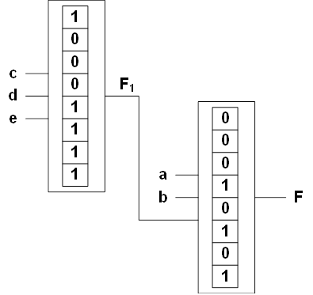
مثال
با LUTهای سه ورودی
F(a, b, c, d, e) = (a + b) . (c + d' . e')
F1 = c + d' . e'
F2 = (a + b).F1

Slide 32
Logic Cell نمونه
Spartan Logic Cell

Slide 33
ساختار FPGA

Slide 34
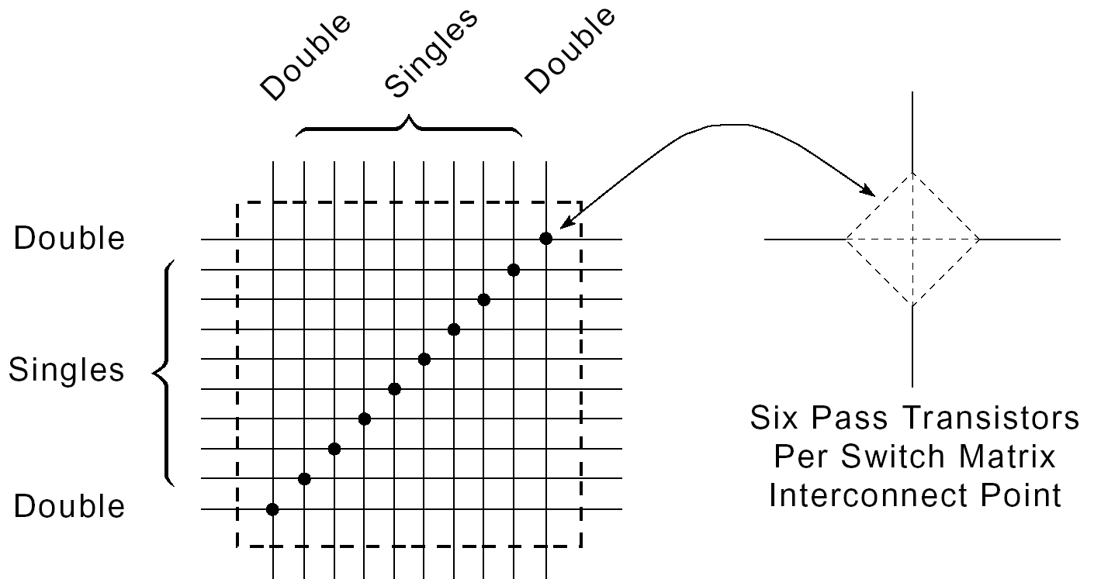
Programmable Switch Matrix (PSM)

Slide 35
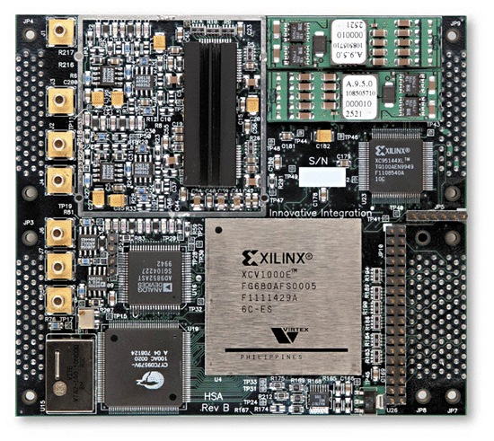
SRAM-Based FPGA
Programmable routing structure
Programmable Logic Blocks
[Entegra]

